Slide 1
COMP 3500 Introduction to Operating Systems Project 5 – Virtual Memory Manager Part 4: Implementing LRU in TLB
Dr. Xiao Qin
Auburn University http://www.eng.auburn.edu/~xqin
xqin@auburn.edu
Notes:
25 Minutes
See also: Lec16a-Project 5 LRU Implementation Draft.pdf in the lectures folder.

Slide 2
From Data Structures to Algorithms
Data Structure
Algorithm Design
Implementation

Slide 3
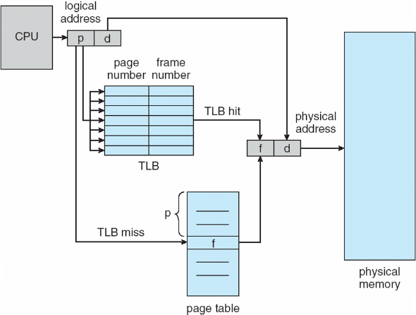
Paging Hardware with Translation Look-aside Buffers (TLB)

Slide 4
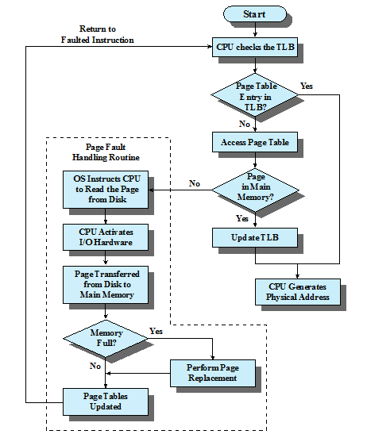
Paging and Translation Lookaside Buffer (TLB)

Slide 5
Least Recently Used (LRU)
Replaces the entry in TLB that has not been referenced for the longest time
By the principle of locality, this should be the entry least likely to be referenced in TLB in the near future
Notes:
The least recently used (LRU) policy replaces the page in memory that has
not been referenced for the longest time. By the principle of locality, this should
be the page least likely to be referenced in the near future. And, in fact, the LRU
policy does nearly as well as the optimal policy. The problem with this approach is
the difficulty in implementation. One approach would be to tag each page with the
time of its last reference; this would have to be done at each memory reference,
both instruction and data. Even if the hardware would support such a scheme, the
overhead would be tremendous. Alternatively, one could maintain a stack of page
references, again an expensive prospect.

Slide 6
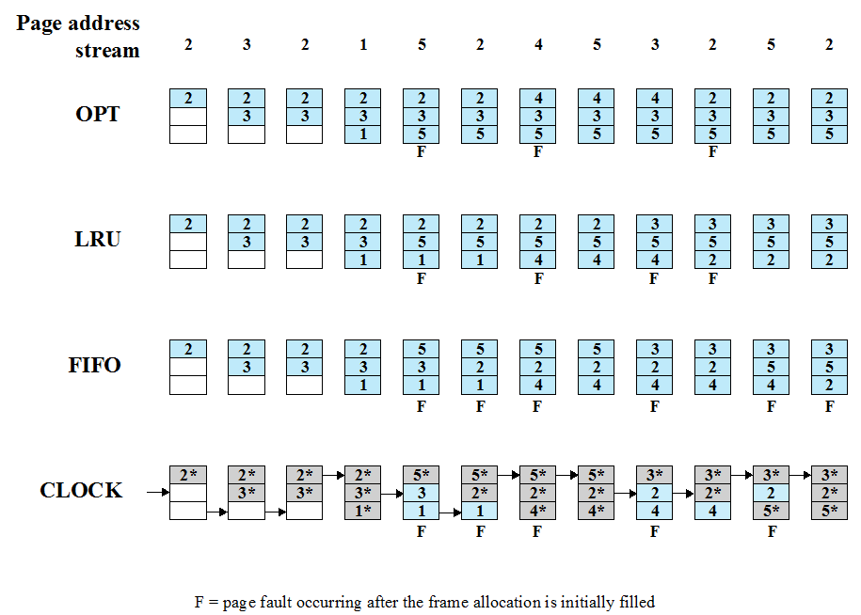
Notes:
Use the white board to illustrate the idea of LRU.
The optimal policy selects for replacement that page for which the time to the next
reference is the longest. It can be shown that this policy results in the fewest number of
page faults [BELA66]. Clearly, this policy is impossible to implement, because it would
require the operating system to have perfect knowledge of future events. However, it
does serve as a standard against which to judge real-world algorithms.
Figure 8.14 gives an example of the optimal policy. The example assumes a
fixed frame allocation (fixed resident set size) for this process of three frames. The
execution of the process requires reference to five distinct pages. The page address
stream formed by executing the program is
2 3 2 1 5 2 4 5 3 2 5 2
which means that the first page referenced is 2, the second page referenced is 3, and
so on. The optimal policy produces three page faults after the frame allocation has
been filled.

Slide 8
Exercise 1
Work with your group member to extend the data structure of TLB, where the LRU replacement policy will be implemented:
typedef struct {
page_t page_num;
frame_t frame_num;
bool valid; /* indicate if this entry is valid */
}tlb_entry_t;
typedef struct {
tlb_entry_t tlb_entry[TLB_SIZE];
/* next candidate entry to be replaced/used */
u_int_t next_tlb_ptr;
}tlb_t;

Slide 9
Exercise 2
Work with your group member to design the LRU replacement policy for your TLB.
typedef struct {
page_t page_num;
frame_t frame_num;
bool valid; /* indicate if this entry is valid */
}tlb_entry_t;
typedef struct {
tlb_entry_t tlb_entry[TLB_SIZE];
u_int_t next_tlb_ptr; /* next candidate entry to be replaced/used */
}tlb_t;

